Slide 1
Twisted Tic-Tac-Toe

Slide 2

Twisted
Event-Driven networking engine in Python
Allows for asynchronous connections to clients

Slide 3
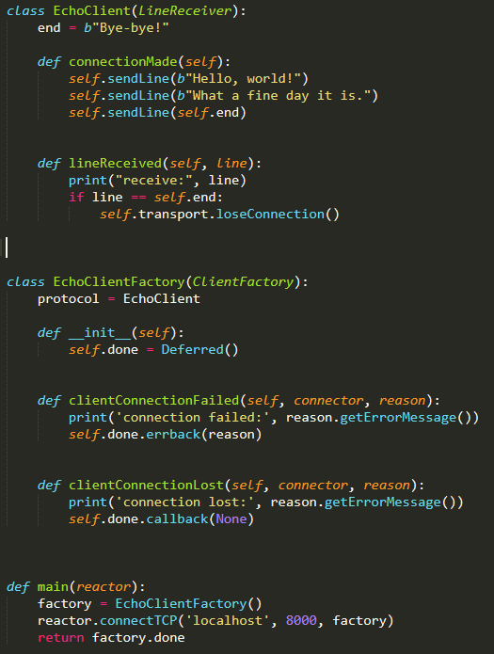
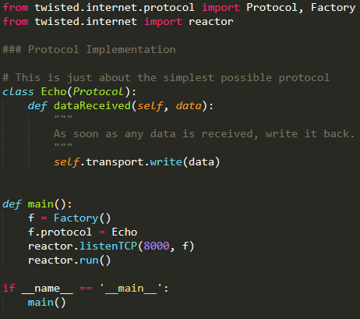
Example

Slide 4

Example cont.

